Slide 1

Recursion
Dr. Aiman Hanna
Department of Computer Science & Software Engineering
Concordia University, Montreal, Canada
These slides has been extracted, modified and updated from original slides of :
Data Structures and Algorithms in Java, 5th edition. John Wiley& Sons, 2010. ISBN 978-0-470-38326-1.
Data Structures and the Java Collections Framework by William J. Collins, 3rdedition, ISBN 978-0-470-48267-4. Both books are published by Wiley.
Copyright © 2010-2011 Wiley
Copyright © 2010 Michael T. Goodrich, Roberto Tamassia
Copyright © 2011 William J. Collins
Copyright © 2011-2012 Aiman Hanna
All rights reserved
Recursion
Notes:
Sequences

Slide 2
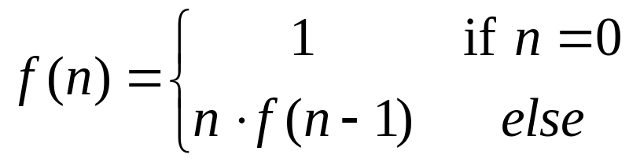
The Recursion Pattern
Recursion: when a method calls itself
Classic example: the factorial function:
n! = 1· 2· 3· ··· · (n-1)· n
Recursive definition:
As a Java method:
  // recursive factorial function
  public static int recursiveFactorial(int n) {
  if (n == 0) return 1; // base case
  else return n * recursiveFactorial(n- 1); // recursive case
  }
Recursion

Slide 3
Content of a Recursive Method
Base case(s)
  Also referred to as stopping cases. These are the cases where the method performs NO more recursive calls.
  There should be at least one base case.
  Every possible chain of recursive calls must eventually reach a base case.
Recursive calls
  Calls to the method itself.
  Each recursive call should be defined so that it makes progress towards a base case.
Recursion

Slide 4
Visualizing Recursion
Example
Recursion trace
  A box for each recursive call
  An arrow from each caller to callee
  An arrow from each callee to caller showing return value
call
return
4
*
6
=
24
final answer
recursiveFactorial
(
4
)
call
return
3
*
2
=
6
recursiveFactorial
(
3
)
call
return
2
*
1
=
2
recursiveFactorial
(
2
)
call
return
1
*
1
=
1
recursiveFactorial
(
1
)
call
return
1
recursiveFactorial
(
0
)
Recursion

Slide 5
Linear Recursion
Simplest form of recursion, where the method makes at most one recursive call each time it is invoked.
Very useful when the problem is viewed in terms of first or last element, plus a remaining set that has the same structure as the original set.
For instance, obtaining the summation of n values in an array can be viewed as:
  Obtaining the sum of the first n-1 elements plus the value of the last element;
  If the array has only one element, then the summation is that single value, A[0] .
Recursion

Slide 6
Example of Linear Recursion
Example recursion trace:
Algorithm LinearSum(A, n):
Input:
An integer array A and an integer n >= 1, such that A has at least n elements
Output:
The sum of the first n integers in A
if n = 1 then
return A[0]
else
return LinearSum(A, n - 1) + A[n - 1]
call
return
15
+
A
[
4
] =
15
+
5
=
20
LinearSum
(
A
,
5
)
call
return
13
+
A
[
3
] =
13
+
2
=
15
LinearSum
(
A
,
4
)
call
return
7
+
A
[
2
] =
7
+
6
=
13
LinearSum
(
A
,
3
)
call
return
4
+
A
[
1
] =
4
+
3
=
7
LinearSum
(
A
,
2
)
call
return
A
[
0
] =
4
LinearSum
(
A
,
1
)
A
4 | 3 | 6 | 2 | 5
Recursion

Slide 7
Example: Reversing an Array
Algorithm ReverseArray(A, i, j):
Input: An array A and nonnegative integer indices i and j
Output: The reversal of the elements in A starting at index i and ending at j
if i < j then
Swap A[i] and A[ j]
ReverseArray(A, i + 1, j - 1)
return
Recursion

Slide 8
Defining Arguments for Recursion
In creating recursive methods, it is important to define the methods in ways that facilitate recursion.
This sometimes requires additional parameters to be passed to the method.
For example, we defined the array reversal method as ReverseArray(A, i, j), not ReverseArray(A).
Recursion

Slide 9
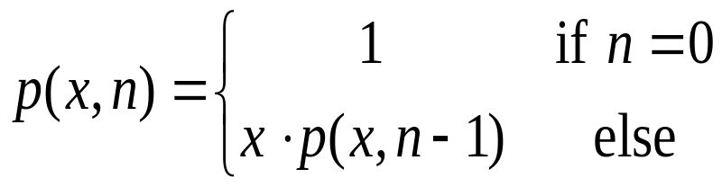
Example: Computing Powers
The power function, p(x,n)=x^{n}, can be defined recursively:
This leads to a power function that runs in O(n) time (for we make n recursive calls).
However, can we do better than this?
Recursion

Slide 10
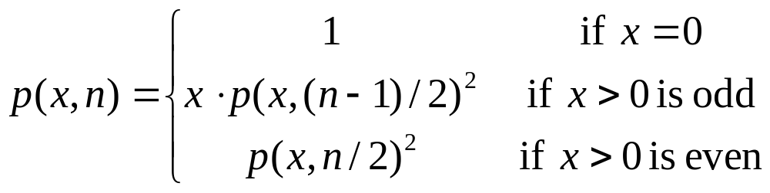
Recursive Squaring
We can derive a more efficient linearly recursive algorithm by using repeated squaring:
For example,
  2⁴ = 2^{(4/2)2} = (2^{4/2})² = (2²)² = 4² = 16
  2⁵ = 2^{1+(4/2)2} = 2(2^{4/2})² = 2(2²)² = 2(4²) = 32
  2⁶ = 2^{(6/ 2)2} = (2^{6/2})² = (2³)² = 8² = 64
  2⁷ = 2^{1+(6/2)2} = 2(2^{6/2})² = 2(2³)² = 2(8²) = 128.
Recursion

Slide 11
Recursive Squaring Method
Algorithm Power(x, n):
Input: A number x and integer n = 0
Output: The value x^{n}
if n = 0 then
return 1
if n is odd then
y = Power(x, (n - 1)/ 2)
return x · y ·y
else
y = Power(x, n/ 2)
return y · y
Recursion

Slide 12
Analysis
Algorithm Power(x, n):
Input: A number x and integer n = 0
Output: The value x^{n}
if n = 0 then
return 1
if n is odd then
y = Power(x, (n - 1)/ 2)
return x · y · y
else
y = Power(x, n/ 2)
return y · y
Each time we make a recursive call we halve the value of n; hence, we make log n recursive calls. That is, this method runs in O(log n) time.
It is important that we use a variable twice here rather than calling the method twice.
Recursion

Slide 13
Tail Recursion
Tail recursion occurs when a linearly recursive method makes its recursive call as its last step; as in the array reversal method.
Such methods can be easily converted to non-recursive methods (which saves on some resources).
Example:
  Algorithm IterativeReverseArray(A, i, j ):
  Input: An array A and nonnegative integer indices i and j
  Output: The reversal of the elements in A starting at index i and ending at j
  while i < j do
    Swap A[i ] and A[ j ]
    i = i + 1
    j = j - 1
  return
Recursion

Slide 14
Binary Recursion
Binary recursion occurs whenever there are two, and exactly two, recursive calls for each non-base case.
Applicable, for instance, when attempting to solve two different halves of some problem.
Example: Calculating the summation of an n array elements, can be done by:
  Recursively summing the elements in the first half;
  Recursively summing the elements in the second half;
  Adding the two values.
Recursion

Slide 15




Example: Summing Array Elements
Example: Summing n consecutive elements of an array, starting from a given index i, using binary recursion
Algorithm binarySum(A, i, n)
Input An array A and integers i and n
Output The sum of the n element of A, starting at index i
if n =1 then
return A[0]
return binarySum(A, i, n/2 ) + binarySum(A, i + n/2 , n/2 )
Recursion

Slide 16
Example: Summing Array Elements
The following provides an example of a
binarySum(0, 8) trace, where each box indicates the starting index and the number of elements to sum.
Analysis: In every half, the call will be made n-1 times, resulting in a total of 2n - 1 calls ➔ O(n).
However, it should be noted that there is a maximum of 1 + log₂ n active calls at any point of time, which improves space utilization as we discuss later.
0
,
8
0
,
4
4
,
4
0
,
2
2
,
2
4
,
2
6
,
2
0
,
1
1
,
1
2
,
1
3
,
1
4
,
1
5
,
1
6
,
1
7
,
1
Recursion

Slide 17
Example: Fibonacci Numbers
In mathematics, the Fibonacci numbers are the numbers in the following integer sequence:
By definition, the first two Fibonacci numbers are 0 and 1, and each subsequent number is the sum of the previous two.
Fibonacci numbers can be defined recursively as:
    F₀ = 0
    F₁ = 1
    F_{i} = F_{i-1} ⁺ F_{i-2} for i > 1.
Recursion

Slide 18
Example: Fibonacci Numbers
Recursive algorithm (first attempt):
  Algorithm binaryFib(k):
  Input: Nonnegative integer k
  Output: The k^{th} Fibonacci number F_{k}
  if k ≤ 1 then
  return k
  else
  return binaryFib(k - 1) + binaryFib(k - 2)
Recursion

Slide 19
Example: Fibonacci Numbers
Analysis: Let n_{k} be the number of recursive calls (notice that this is not the value) by binaryFib(k)
  n₀ = 1
  n₁ = 1
  n₂ = n₁ + n₀ + 1 = 1 + 1 + 1 = 3
  n₃ = n₂ + n₁ + 1 = 3 + 1 + 1 = 5
  n₄ = n₃ + n₂ + 1 = 5 + 3 + 1 = 9
  n₅ = n₄ + n₃ + 1 = 9 + 5 + 1 = 15
  n₆ = n₅ + n₄ + 1 = 15 + 9 + 1 = 25
  n₇ = n₆ + n₅ + 1 = 25 + 15 + 1 = 41
  n₈ = n₇ + n₆ + 1 = 41 + 25 + 1 = 67.
Note that n_{k} at least doubles every other time.
That is, n_{k} > 2^{k/2}. It is exponential!
Recursion

Slide 20
Example: Fibonacci Numbers
The main problem with binaryFib(k) approach is that the computation of Fibonacci numbers is really a linearly recursive problem, in spite of its look where F_{k} depends on F_{k-1} and F_{k-2}.
The problem is hence not a good candidate for binary recursion.
We should use linear recursion instead.
Recursion

Slide 21
A Better Fibonacci Algorithm
Use linear recursion instead
    Algorithm linearFibonacci(k):
    Input: A nonnegative integer k
    Output: Pair of Fibonacci numbers (F_{k} , F_{k-1})
      if k = 1 then
      return (k, 0)
      else
      (i, j) = linearFibonacci(k - 1)
      return (i +j, i)
      // notice that the values are retuned (however, not both are displayed)
linearFibonacci makes k-1 recursive calls, so total calls is k.
➔ See LinearFib.java & BinaryFibStack.java
Recursion

Slide 22
A Better Fibonacci Algorithm
For instance (note: Fib is short for linearFibonacci),
Fib(2) ➔ (i+j, i) is (1,1) ➔ Will be displaying 1
Fib(3) ➔ (i+j, i) is (2,1) ➔ Will be displaying 2
Fib(4) ➔ (i+j, i) is (3,2) ➔ Will be displaying 3
Fib(5) ➔ (i+j, i) is (5,3) ➔ Will be displaying 5
Fib(6) ➔ (i+j, i) is (8,5) ➔ Will be displaying 8
Fib(7) ➔ (i+j, i) is (13,8) ➔ Will be displaying 13
Fib(8) ➔ (i+j, i) is (21,13) ➔ Will be displaying 21
Fib(9) ➔ (i+j, i) is (34,21) ➔ Will be displaying 34
:
Fib(12) ➔ (i+j, i) is (144,89) ➔ Will be displaying 144
Recursion

Slide 23
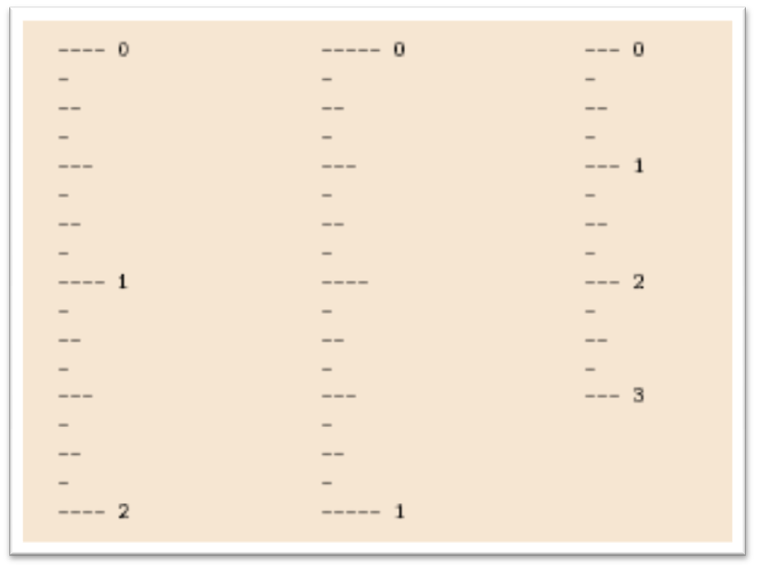
Binary Recursion
Another Example
The English Ruler:
  Print the ticks and numbers like an English ruler
Recursion

Slide 24
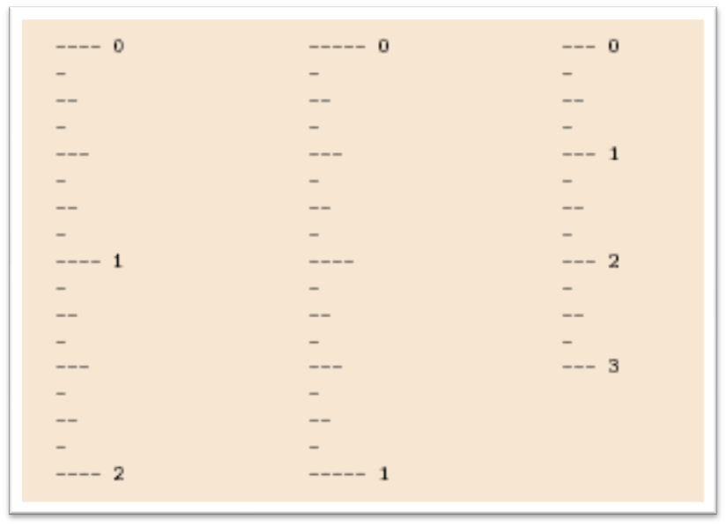
Example: The English Ruler
Slide by Matt Stallmann included with permission.
drawTicks(length)
    Input: length of a ‘tick’
    Output: ruler with tick of the given length in the middle and smaller rulers on either side
drawTicks(length)
if( length > 0 ) then
drawTicks( length − 1 )
draw tick of the given length
drawTicks( length − 1 )
Recursion

Slide 25
Recursive Drawing Method
The drawing method is based on the following recursive definition
An interval with a central tick length L >1 consists of:
  An interval with a central tick length L−1
  An single tick of length L
  An interval with a central tick length L−1
drawTicks
(
3
)
Output
drawTicks
(
2
)
drawTicks
(
1
)
drawTicks
(
0
)
drawOneTick
(
1
)
drawTicks
(
0
)
drawOneTick
(
2
)
drawTicks
(
1
)
drawTicks
(
0
)
drawOneTick
(
1
)
drawTicks
(
0
)
drawOneTick
(
3
)
drawTicks
(
2
)
(
previous pattern repeats
)
Recursion

Slide 26
Java Implementation (1)
// draw ruler
public static void drawRuler(int nInches, int majorLength) {
drawOneTick(majorLength, 0); // draw tick 0 and its label
for (int i = 1; i <= nInches; i++) {
drawTicks(majorLength- 1); // draw ticks for this inch
drawOneTick(majorLength, i); // draw tick i and its label
}
}
// draw ticks of given length
public static void drawTicks(int tickLength) {
if (tickLength > 0) { // stop when length drops to 0
drawTicks(tickLength- 1); // recursively draw left ticks
drawOneTick(tickLength); // draw center tick
drawTicks(tickLength- 1); // recursively draw right ticks
}
}
Note the two recursive calls
Recursion

Slide 27
Java Implementation (2)
// draw a tick with no label
public static void drawOneTick(int tickLength) { drawOneTick(tickLength, - 1);
}
// draw one tick
public static void drawOneTick(int tickLength, int tickLabel) {
for (int i = 0; i < tickLength; i++)
System.out.print("-");
if (tickLabel >= 0) System.out.print(" " + tickLabel);
System.out.print("\n");
}
Recursion

Slide 28
Multiple Recursion
Multiple recursion:
  makes potentially many recursive calls
  not just one or two
Motivating example:
  Coping folders (directories)
  summation puzzles
    pot + pan = bib
    dog + cat = pig
    boy + girl = baby
Recursion

Slide 29
Example of Multiple Recursion
Algorithm CopyFolder(folder):
Input: A directory folder, which possibly includes files and subfolders
Output: A copy of the given folder with all its files and subfolders
for all files in folder do
copy file
for all subfolder in folder do
copyfolder(subfolder) // this line is where recursion happens
Recursion

Slide 30
Example of Multiple Recursion
Algorithm PuzzleSolve(k,S,U):
Input: Integer k, sequence S, and set U (universe of elements to test)
Output: Enumeration of all k-length extensions to S using elements in U without repetitions
for all e in U do
Remove e from U {e is now being used}
Add e to the end of S
if k = 1 then
Test whether S is a configuration that solves the puzzle
if S solves the puzzle then
return “Solution found: ” S
else
PuzzleSolve(k - 1, S,U)
Add e back to U {e is now unused}
Remove e from the end of S
Recursion

Slide 31
Example of Multiple Recursion
Slide by Matt Stallmann included with permission.
cbb + ba = abc
a,b,c stand for 7,8,9; not necessarily in that order
799 + 98 = 997
[] {a,b,c}
[a] {b,c}
a=7
[b] {a,c}
b=7
[c] {a,b}
c=7
[ab] {c}
a=7,b=8
c=9
[ac] {b}
a=7,c=8
b=9
[ca] {b}
c=7,a=8
b=9
[cb] {a}
c=7,b=8
a=9
[ba] {c}
b=7,a=8
c=9
[bc] {a}
b=7,c=8
a=9
might be able to
stop sooner
Recursion

Slide 32
Visualizing PuzzleSolve
Notice that the number of concurrently active calls can still be limited with multiple recursion.
For instance, the number of active calls of CopyFolder depends on how many nested subfolders may exist at a time and not on the total number of subfolders in the directory.
Initial call
PuzzleSolve
(
3
,
()
,{
a
,
b
,
c
}
)
PuzzleSolve
(
2
,
a
,{
b
,
c
}
)
PuzzleSolve
(
2
,
b
,{
a
,
c
}
)
PuzzleSolve
(
2
,
c
,{
a
,
b
}
)
PuzzleSolve
(
1
,
ab
,{
c
}
)
PuzzleSolve
(
1
,
ba
,{
c
}
)
PuzzleSolve
(
1
,
ca
,{
b
}
)
abc
bac
cab
PuzzleSolve
(
1
,
ac
,{
b
}
)
PuzzleSolve
(
1
,
bc
,{
a
}
)
PuzzleSolve
(
1
,
cb
,{
a
}
)
Recursion
acb
bca
cba

Slide 33
Recursion & The Stack
A running Java program maintains a private memory area called the stack, which is used to keep track of the methods as they are invoked.
Whenever a method is invoked, its information (parameters, local variables, Program Counter (PC), …) is placed as one frame into the stack.
The frame is removed from the stack once the method returns.
Recursion

Slide 34
Recursion & The Stack
main()
{ …
fun1();
…
}
fun1()
{ …
fun5();
…
}
fun5():
PC = 328
m = 2
n = 5
fun1():
PC = 229
y = 7
Frames
main():
PC = 24
x = 10
Java Stack
Recursion

Slide 35
Recursion & The Stack
The heap is another memory area that is maintained for a running program.
The heap is used for dynamic allocation of memory at runtime (i.e. when new is called to create an object).
Usually the stack and the heap grow against each other in the memory.
Recursion has hence the potential of overflowing the stack by quickly consuming all available space.
➔ See Recursion3.java
Recursion

